Slide 1
CMSE 201
Fundamentals of Software Engineering
Prof. Dr. Alexander Chefranov
Room: CMPE 219
Email: Alexander.chefranov@emu.edu.tr
You can reach to me from:
MS Teams/e-mail

Slide 2
BOOKS
Ian Sommerville, Engineering Software Products: An Introduction to Modern Software Engineering, ISBN-10: 013521064X • ISBN-13: 9780135210642 ©2020 • Pearson, 352 pp, Published 18 Feb 2019
Ian Sommerville, Software Engineering 10e, Global Edition, 2016.
Shari Lawrence Pfleeger, Joanne M. Atlee, Software Engineering: Theory and Practice, 4/E ISBN-10: 0136061699 • ISBN-13: 9780136061694 ©2010 • Pearson, 800 pp,
Joseph S. Valacich and Joey F. George, Modern Systems Analysis and Design, 9th Edition, Pearson Education Limited ©2021 ISBN 10: 1-292-35162-4, ISBN 13: 978-1-292-35162-9
Ganesh Vaidyanathan, Project Management: Process, Technology and Practice, Indiana University, South Bend, ISBN-10: 0132807181 • ISBN-13: 9780132807180 ©2013.

Slide 3
COURSE OVERVİEW
ACTIVITIES:
  Formal lectures
  May be, Invited industrial speakers (Team Leaders, Gen. Mang, etc.)
  3 Stage assignment: a group Project (at most 4 students)

Slide 4
Course Web Page
https://staff.emu.edu.tr/alexanderchefranov/en/teaching/cmse201

Slide 5
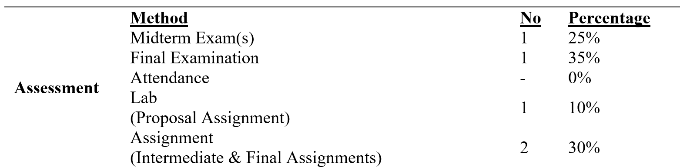
Grading Policy
- Attendance is taken every lecture and entered to EMU portal. Those attending less than 20% of classes without valid excuse may get NG grade
If you miss a midterm or final exam, you can take a make-up exam (for the midterm or final exam) if you have valid excuses (e.g., you are sick) and provide material evidence for it (e.g., a doctor’s report which must be issued/approved by EMU Health Center) within 3 working days of the exam. Resit exam may be taken according to its rules.
There will be no make-up for labs
Any student caught cheating at the exams or assignments will automatically fail the course and may be sent to the disciplinary committee at the discretion of the instructor

Slide 6
YOUR PROJECT
Each Project Team (at most 4 students) to prepare
  Develop a software project (PROGRAMMING IS OPTIONAL)
  TWO Presentations: Intermediate and Final
  Students will prepare 3 REPORTS for term project and 2 presentation:
    1-First_Project_Report_Template-PROPOSAL
    2-Intermediate_Project_Report_Template-SRS
    3-Final_Project_Report_Template-FINAL REPORT

Slide 7
TERM PROJECT
Contact with your lab assistant
Define your team members (AT MOST 4 stds)
Assign the role/roles to each member in your team.
  Project Manager/Lead Systems Analyst/Lead Programmer (1 STD)
  Database Developer/Administrator/Programmer (1 STD)
  User Interface Designer/Web Developer (1 STD)
  Network Designer/HW Designer/Tester (1 STD)
  Mentor/Customer(Your Assistant)

Slide 8
TOPICS
Select One Project from the following list and see project description document:
https://nevonprojects.com/project-ideas/software-project-ideas/
https://www.elprocus.com/top-software-engineering-projects-for-it-and-cse-students-in-2014/
https://nevonprojects.com/web-based-project-ideas-topics/
https://nevonprojects.com/project-ideas/android-project-ideas/
https://nevonprojects.com/ios-projects/#startscroll

Slide 9
TOPICS not limited...but suggested...
E-health Recommendation based Mobile Systems
For patients
For adults
For medical staffs
For medical laboratory systems etc.
Safety Food Consumption Mobile System
E-learning etc...

Slide 10
TOOLS
User Interface Design: https://mockitt.wondershare.com/software-design/ui-design-software.html
SketchUp (2D/3D User Interfaces, others,etc), https://www.youtube.com/watch?v=k46nr-42Mu0
User Interface Design: MockFlow Tool, https://www.youtube.com/watch?v=lD5lT3LX0Ck
User Interface Design: Adobe XD
Programming: Java or .NET, Phyton etc. platforms
SE Design Tools: Modelio, Visual Paradigm, www.lucidchart.com, www.edrawsoft.com, etc. or another SW tool for design activities. DON’T USE MS VISIO etc…
LEARN MODELIO TOOL:
  https://www.modelio.org/910-modelio/tutorials.html
  https://www.modeliosoft.com/en/
  https://www.modelio.org/
  https://www.modeliosoft.com/en/resources/videos-demos.html
  https://www.modelio.org/resources-menu/videos.html
Project Management Tool: Create your project by using the MS Project or MS OpenPrj Tools. See Tutorials:
    https://www.youtube.com/watch?v=sSS1tu1yQ-Q
    https://www.youtube.com/watch?v=yEclUahpSbs
    https://www.youtube.com/watch?v=4mfgajCVTvU

Slide 11
3 REPORTS
SEE PROJECT_PACKAGE folder
  1-First_Project_Report_Template-PPM (Proposal)
  2-Intermediate_Project_Report_Template-SRS
  3-Final_Project_Report_Template-FINAL

Slide 12

1st STAGE OF YOUR ASSIGNMENT:
Preapare Your Planning& Management Report (PPM)
PPM report will be submitted in the required format!
Should include:
Define your topic, scope, plans, aim, problem definitions, etc..
WBS
Gantt Chart in MS Project Tool or OpenPrj (see tutorial videos p.8, p.13,p.14)
Organization Chart
Project Planning & Feasibility studies

Slide 13
2nd STAGE OF YOUR ASSIGNMENT:
INTERMEDIATE PRESENTATION & REPORT
(Deadline is already announced on website)
1-A short intermediate presentation (15 mins)
  each member will talk
2-Submit your SRS documents as an intermediate report:
  Intermediate_Project_Report_Template-SRS

Slide 14
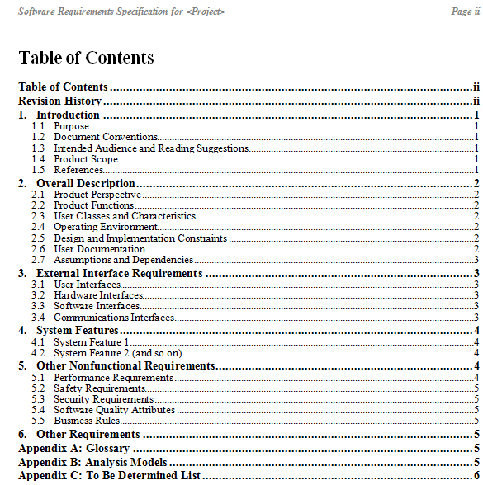
A sample of a basic SRS outline-IEEE format.
(Software Requirements Specification Format)
SEE: SRS Examples in STUDENT_PROJECT_PACKAGE folder

Slide 15
3rd STAGE OF YOUR ASSIGNMENT:
FINAL PRESENTATION & REPORT
(Deadline is already announced on website)
Final Presentation (each member will talk)
  Presentation
    Design of System Modules
    Demo of Prototype System (OPTIONAL)
  Final_Project_Report_Template-FINAL document contains:
    All SDLC stages
    All planning documents on the MS Project Tool or OpenPrj, IBM Rat. Tools
    All design documents on the Modelio, iodraw, Visual Paradigm, or IBM Rational, etc.
    All performed documentations (design, test,…)

Slide 16

FINAL REPORT???
FINAL REPORT = Planning & Management Report (PPM) + Intermedıate Report (SRS)

Slide 17
FOR STARTING YOUR ASSIGNMENT
See PROJECT_PACKAGE folder
  Report templates
  Example projects

Slide 18
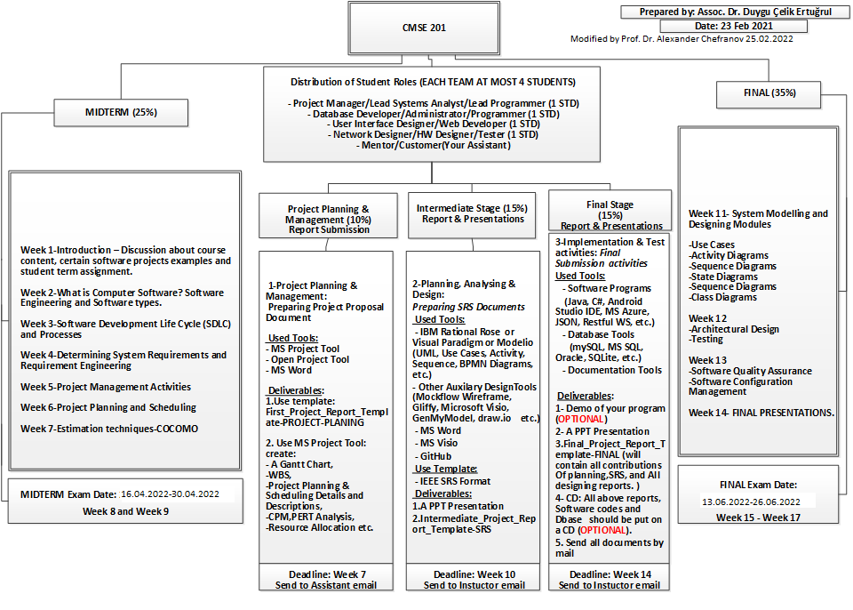

Slide 19
SOME USEFUL TOOLS AND RESOURCES
To view the tutorial, you need watch some videos:
WATCH FOLLOWING VIDEOs TO LEARN SOFTWARE DESIGN METHODS!
Creating UML diagrams by using Rational Rose ***
https://www.youtube.com/watch?v=gGAqSoCb3pU
https://www.youtube.com/watch?v=41oSlgY3c4o
Create your project via MS Project Tool ***
https://www.youtube.com/watch?v=sSS1tu1yQ-Q
Rational Rhapsody samples and tutorials
https://www.youtube.com/watch?v=zODaYlqL1_A
https://www.youtube.com/watch?v=l4nqIZiyt5E
https://www.youtube.com/watch?v=yaLGw-ZSUKk
Gantt Chart ***
https://www.youtube.com/watch?v=sSS1tu1yQ-Q
Use Case diagrams ***
http://homepages.uel.ac.uk/D.Bowden/Creating_use_case_diagram/Creating_use_case_diagram.viewlet/Creating_use_case_diagram.swf
Class diagrams ***
http://homepages.uel.ac.uk/D.Bowden/Creating_Class_Diagram/Creating_Class_Diagram.viewlet/Creating_Class_Diagram.swf
Sequence Diagrams ***
http://homepages.uel.ac.uk/D.Bowden/Creating_Sequence_Diagrams/Creating_Sequence_Diagrams.viewlet/Creating_Sequence_Diagrams.swf
Message Sequence Charts (MSC)
http://www.sdl-forum.org/MSC/msctutorial.pdf
Collaboration diagrams
http://homepages.uel.ac.uk/D.Bowden/Creating_collaboration/Creating_collaboration.viewlet/Creating_collaboration.swf
State chart diagrams
http://homepages.uel.ac.uk/D.Bowden/Creating_State_Diagram/Creating_State_Diagram.viewlet/Creating_State_Diagram.swf

